Slide 1

Capstone 1
Image from:https://www.google.com/url?sa=i&url=https%3A%2F%2Fsouthkingstownri.com%2F998%2FCOVID-19&psig=AOvVaw0Li-SNGRSnrOzyUhO6EItm&ust=1610808037875000&source=images&cd=vfe&ved=0CAIQjRxqFwoTCLiT9N6Vnu4CFQAAAAAdAAAAABAD

Slide 2
Introduction
Currently (on the date 13 Jan 2021), this leads to a total of over 1.9M Deaths across the globe.
Pandemic is spreading all over the world; it becomes more important to understand about this spread.
Data
The dataset used in research is published worldometers website, which can be accessed using the link below:
https://www.worldometers.info/coronavirus/
Research Question:
How accurate are those data presented?
For countries with lower number of death rate, can we rely on those data to represent the true situation?
Are those low death rate simply due to insufficient number of testing performed?
How serious is the true situation if the number of testing is increased?

Slide 3
Method
Hypothesis Testing:
The number of testing performed per million population by different countries are divided into three groups: High Level Testing, Medium Level Testing, and Low Level Testing.
Null Hypothesis: The level of testing is NOT associated with the number of death per million population. Therefore, the mean difference in the total number of death per million population amongst those three groups is zero.
Audience
This research will help Disease Control and Prevention Agencies such as WHO, CDC, as well as Health Professionals/Advisors to gain better understanding of the true situation of the pandemic and identify any improvement can be made towards the testing strategy across the globe.

Slide 4
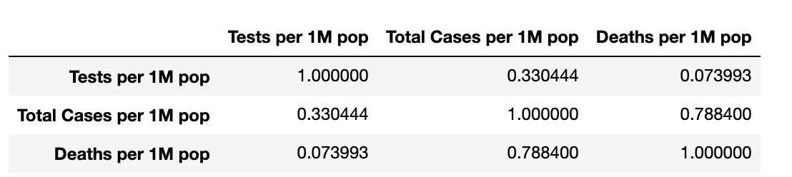
The Pearson Correlation
This coefficient is a number between -1 and 1.
1 means that a strong relationship exists,
-1 means that a strong negative relationship exists
0 means that there is no relationship at all.
Based on the analysis above, there may be a correlation between Death per 1M pop and Total cases per 1M pop, with coefficient of 0.788400

Slide 5
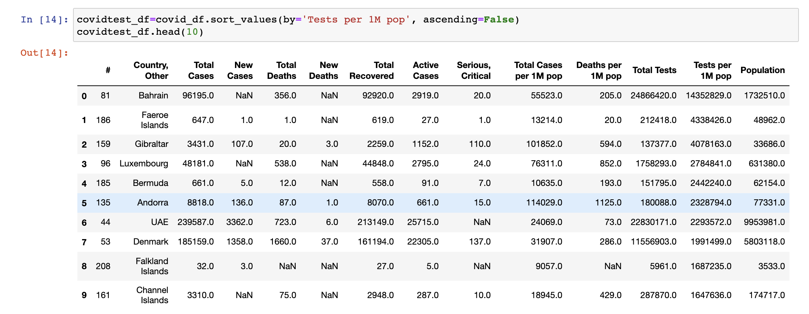
Covid Table sort by Tests Per 1M

Slide 6
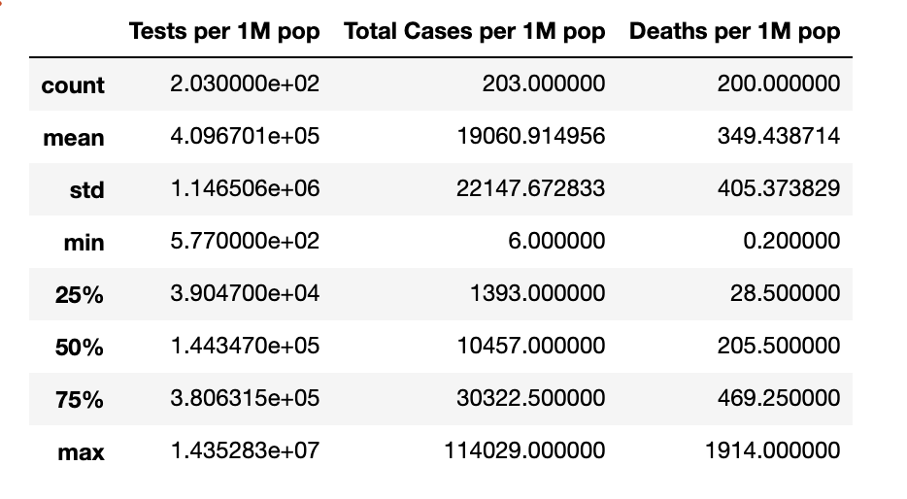
Statistical Details

Slide 7
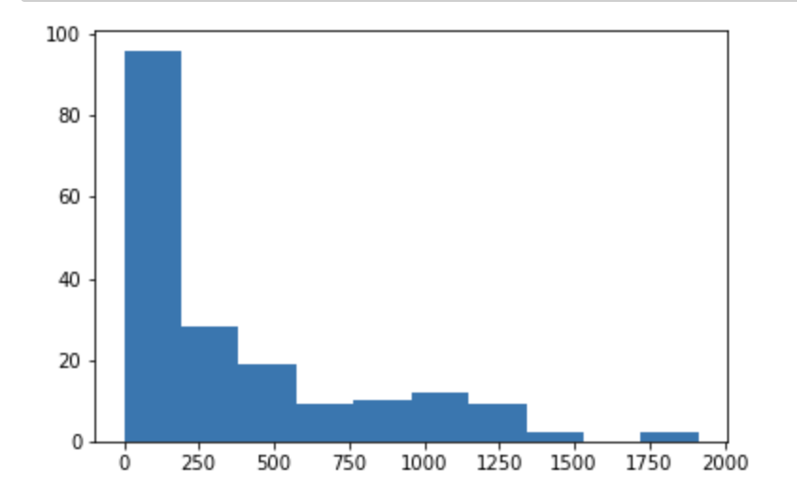
Histogram (General): Deaths / 1M Population
I want to take a closer look into the relationship between death per million population and test per million population to determine if any significant difference on death rate can be identified based on different level of testing. First, I need to understand the distribution of the data, so I need to start with histogram analysis. Below is the histogram of the overall death / 1M population data.

Slide 8
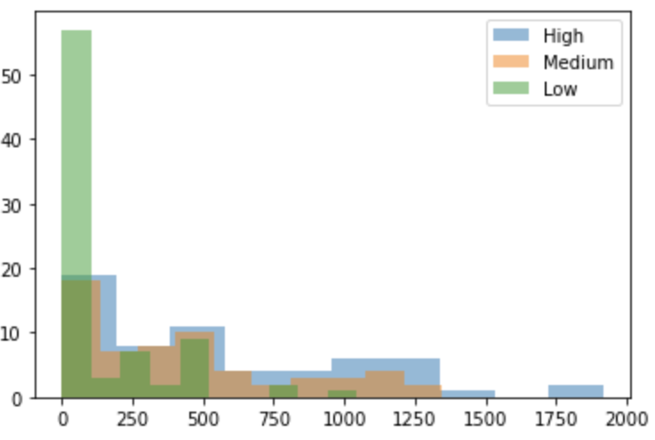
High Level Testing
variance=235644.8508196721,
mean=554.5573770491803
skewness=0.8154267025213013, kurtosis=-0.23031313534159725)
Medium Level of Testing
variance=143531.90190476188,
mean=423.52857142857135
skewness=0.8484500174660172, kurtosis=-0.3601419275981024)
Low Level of Testing
variance=42113.09534920635,
mean=134.64814814814815
skewness=2.2220254534944455, kurtosis=5.33775273848898)
Histogram: Deaths / 1M Population
Then I divided the data into three groups based on total number of testing per million population:
High level testing, Medium level testing, and Low level testing. I then looked into more detailed distribution in each group including the mean and variance between those groups - see detail below:

Slide 9
The Kruskal-Wallis Test:
(alpha = 0.05)
Based on the histogram analysis, all three groups are skewed and not normally distributed so I will have to run a non-parametric test. I decided to run a Kruskal-Wallis test because it is quite skewed and I am working with three variables
statistic=51.62456958685288,
pvalue=6.164064137026368e-12
Based on the Kruskal-Wallis test, the p-value (6.164e-12) obtained is below Alpha value 0.05. A statistically significant test result (P≤ 0.05) means that the test hypothesis is false or should be rejected, therefore the null hypothesis can be rejected, and at least one group’s death rate is significantly different compare the others.
Mann-Whitney Test:
I run Mann-Whitney tests to compare each two groups, to see if any significant difference can be identified between High level/Low Level testing, High level/Medium level testing, and Medium level/Low level testing.
x=High_test, y=Low_test[(statistic=77262.0, pvalue=0.0002717639625187274)
x=High_test, y=Medium_test[(statistic=43979.5, pvalue=0.490508458893215)
x=Medium_test, y=Low_test[(statistic=49199.5, pvalue=0.0006665303742629587)
Again, looking at the p value, both High/Low level testing and Medium/Low level testing had a value below 0.05, where the High/Medium level testing had a value significantly above 0.05. This further indicated that there is a significant difference between H/M level testing against L level testings, with no significant difference identified between High/ Medium level testing groups.

Slide 10
CONCLUSION
Based on the p-values obtained, it seems that the Low level testing group death rate is significant different comparing to High and Medium level testing countries, although no significant difference identified between High level and Medium level testing countries.
Based on the number represented in the histogram, specifically the mean and variance data, M/H testing rate is generally associated with Higher death rate comparing to Low level testing, which could due to testing rate is a reactive action based on the how serious the death rate are.
The death rate is probably higher due to more testing is conducted to link associated death to Covid. In this case, there is a possibility that if higher level testing is conducted in Low level countries, we may see an increase of death rate in those region as well. This potentially indicated that the real situation could be much worse comparing to the number represented currently.

Slide 11

Any Question

